Slide 1
Object-Oriented Programming
Mohammad Salman
Dean’s Fellow

Slide 2
Access Specifiers
Public, Private and Protected

Slide 3
Member Access
Each member in a class has a property called an access level.
This determines who can access that member.
C++ has three different access levels.
Public
Private
Protected (will talk about during inheritance)

Slide 4
Public Members
Accessible anywhere outside the class.
Accessible within the same class (by the member functions).
Accessible within other classes.
Accessible within other functions in the global scope (including main()).
But always, these public members will be accessed through an object.

Slide 5
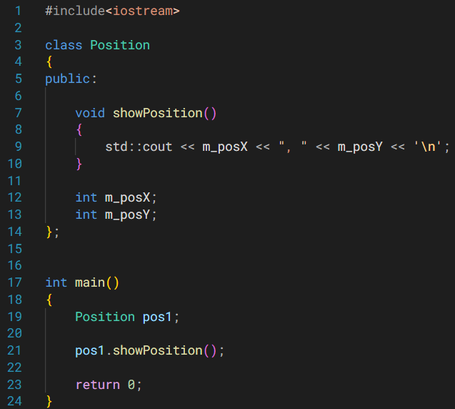
The public members of the class (attributes or methods even) can be accessed within the same class.
This example also shows that public members are accessible in other functions, outside the class.
showPosition() is a public member being called from main().
Note
Even though the attributes come after methods, I can access those same attributes in the methods.
Members can be defined in any order within the class definition.

Slide 6
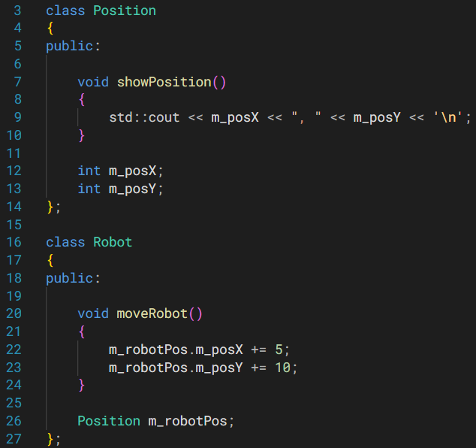
The public members of class Position can be accessed within a different class.

Slide 7
Private Members (Default Access Level in Classes)
Members of a class are private by default.
That is, if you don’t specify any access specifier, members will be considered private.
Private members are members in a class that are only accessible by other members of the same class.

Slide 8
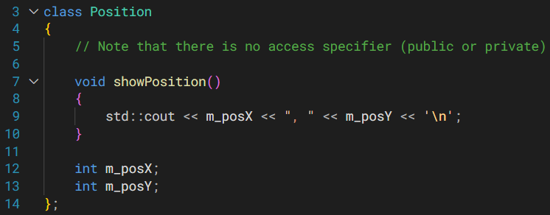
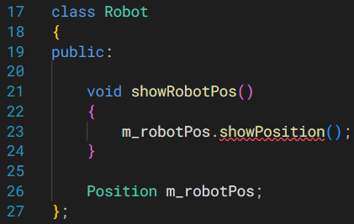
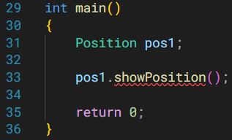
All the three members are private by default.
Note that members are accessible within their own class (e.g. m_posX and m_posY).
But showPosition() is not available anywhere outside the class.

Slide 9
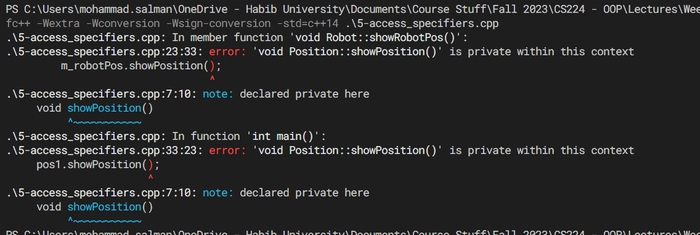
This is the error that comes up.

Slide 10
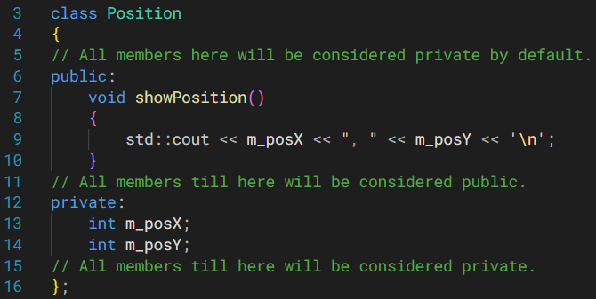
Having multiple access specifiers in your class is possible.

Slide 11
Having multiple access specifiers in your class is possible.

Slide 12
Having multiple access specifiers in your class is possible.

Slide 13


Slide 14
Abstraction
Activity
https://youtu.be/6V1sr0XV_Ng?si=g5gGIsHnm43ateNc
9:59 min mark
Another Important Concept in OOP
https://www.learncpp.com/cpp-tutorial/the-benefits-of-data-hiding-encapsulation/

Slide 15
Abstraction
We want to abstract (or hide) the data away from the programmer who will use our classes.
Or from ourselves when we use other people’s classes.
Abstraction (like encapsulation) is another important principle of OOP.
This allows programmers to use objects without having to understand how they work fully.

Slide 16
Abstraction
The information that programmers could use are the public members (attributes and methods) of the classes.
These public members end up forming the public interface, which other programmers will use to interact with our classes.
Hence, it’s important to not change the public members of your class heavily or often.
Other code dependent on your class would break otherwise.

Slide 17
Abstraction
Therefore, programmers generally want to make a small public interface.
This means that they could make changes to their classes if they wanted, without the users (programmers) ever noticing those changes.
So everyone’s happy.
Better class reusability and maintainability.

Slide 18
Abstraction
Another example could be std::string, std::vector and std::cout.
We can use them w/o worrying about their implementations, which are abstracted/hidden away.
There are many other advantages of abstraction.
They are listed and described in the link on the title slide of this section.
It’s restated here for convenience.
https://www.learncpp.com/cpp-tutorial/the-benefits-of-data-hiding-encapsulation/

Slide 19
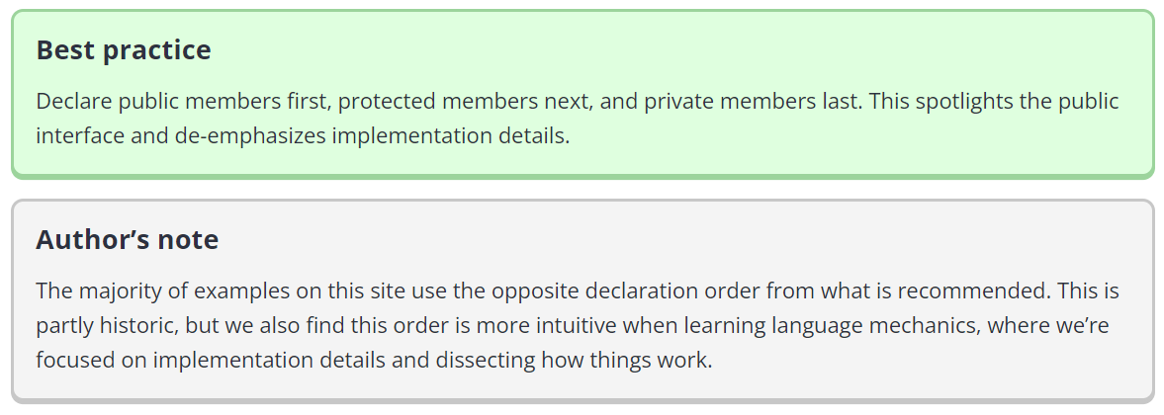

Slide 20
Back to Access Specifiers
This idea we’re about to talk about is important.
https://www.learncpp.com/cpp-tutorial/public-and-private-members-and-access-specifiers/

Slide 21
Access Levels Work on Per-Class Basis
Another way to read the title above would be that,
Access levels do not work on a per-object basis.
What does this mean?

Slide 22
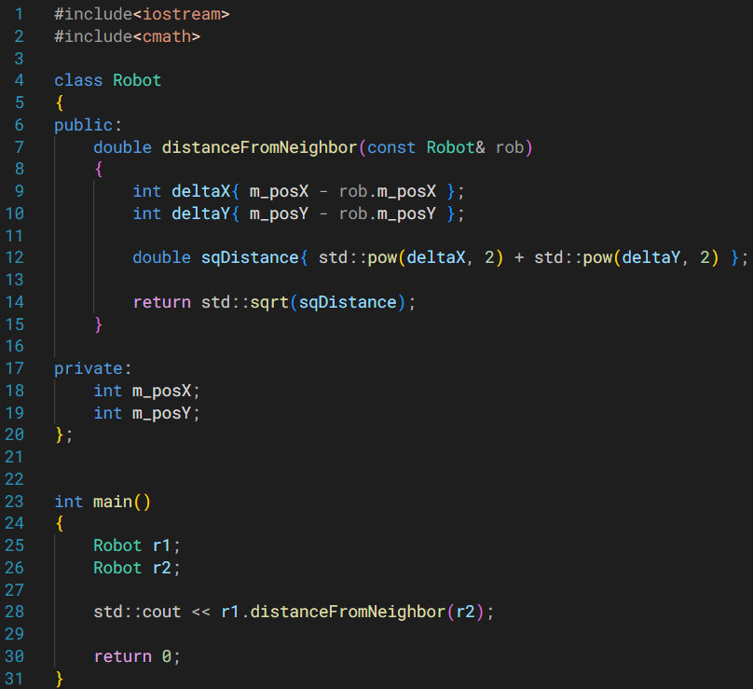
The method is being called through r1 (so r1 is implicitly being passed to the method).
r2 is passed as an argument to the method.
We can say that it’s passed explicitly.

Slide 23
Note the public method in class Robot.
It accepts an object of this same class as a const reference.
Passing by reference helps prevent creating a copy of it.
const ensures that this data will not accidentally be modified by our function.

Slide 24
So within this function, what if I write,
std::cout << m_posX;
std::cout << rob.m_posX;
Btw, the access level of m_posX is private.

Slide 25
So within this function, what if I write,
std::cout << m_posX;
std::cout << rob.m_posX;
Btw, the access level of m_posX is private.
Both statements will work as intended.
Access levels do not work on a per-object basis.
They work on a per-class basis.

Slide 26
Access Levels Work on Per-Class Basis
A member function can directly access private members (of the implicit object).
However, because access levels are per-class, not per-object, a member function can also directly access the private members of ANY other object of the same class type that is in scope.

Slide 27
For Practice (Self-Study)
For practice, you can refer to: https://www.learncpp.com/cpp-tutorial/public-and-private-members-and-access-specifiers/
Check Question #2 under Quiz Time section.
This requires you to create your own class.
Go through this exercise independently, before looking at the solution.
Also, don’t use Google or LLMs (ChatGPT, Bard, etc.) for this; try using your own understanding first.

Slide 28
Getters and Setters
Also called Accessors and Mutators, respectively.

Slide 29
Getters / Setters
Getters (or accessors) are methods used to get (or access) values of private attributes.
Setters (or mutators) are methods used to set (or mutate/change) values of private attributes.
They’re just regular methods; nothing really unique about them.

Slide 30
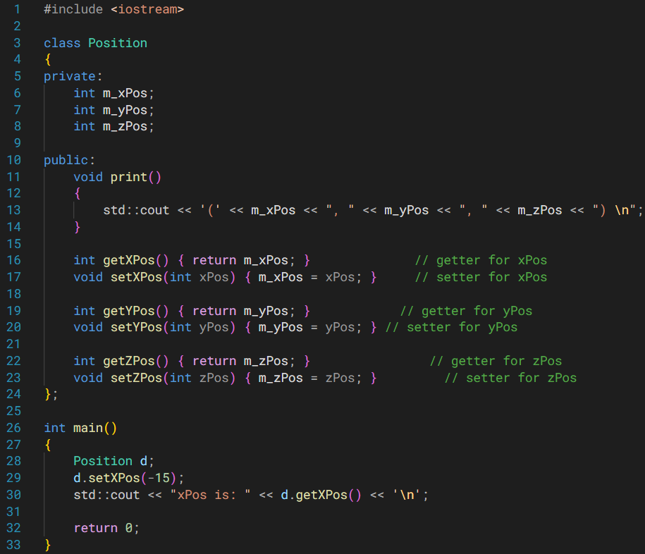
Getters and setters.
Adding “m_” as a prefix to your attribute names is helpful.
Otherwise, you may run the risk of having your local variables of the same name as your attributes.
This will result in scoping issues.

Slide 31
Why Getters and Setters?
What is the point of private when I’m creating public functions to read and update the private members?
Consider this Fraction class.
I will create objects which will simulate or model fractions.
Recall that the denominator of a fraction should not be zero (they become undefined otherwise).

Slide 32
This is a problem, and this can happen if my data is public.
#include <iostream>
class Fraction
{
public:
int m_num;
int m_den;
void print()
{
std::cout << "Fraction(" << m_num << ", "
<< m_den << ")\n";
}
};
int main()
{
Fraction f;
f.m_den = 0;
return 0;
}

Slide 33
If I have private members, direct access will not work.
In this case, I have chosen to define just a getter. So m_den is read-only through the getter.
Hence, I have more control if I have my attribute set to private.
class Fraction
{
private:
int m_num;
int m_den;
public:
int getDen() const
{
return m_den;
}
};
int main()
{
Fraction f;
f.m_den = 0;
return 0;
}

Slide 34
I can also define a setter, but notice that I’m not blindly changing values.
Because a setter is just a function, I can add conditions to verify whether I’m making an appropriate change or not within the setter.
class Fraction
{
private:
int m_num;
int m_den;
public:
int getDen() const
{
return m_den;
}
void setDen(int newDen)
{
if (newDen == 0)
{
// Raise some error and exit function
}
else
{
m_den = newDen;
}
} };
int main()
{
Fraction f;
return 0;
}

Slide 35
const Methods

Slide 36
What are const Methods?
Methods that are const, guarantee that they will not change the attributes of the implicit object.
This is the object that was used to call the method.
Good practice: if we know that a method is not meant to modify the implicit object, we make that method a const.
Should getters and setters be const?
Getters – yes.
Setters – no.
int getXPos() const
{
return m_xPos;
}

Slide 37
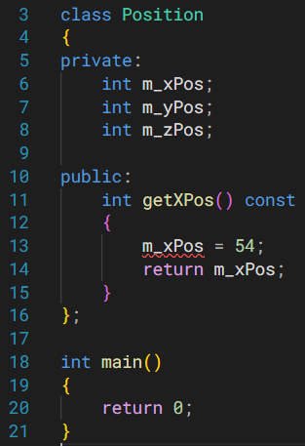
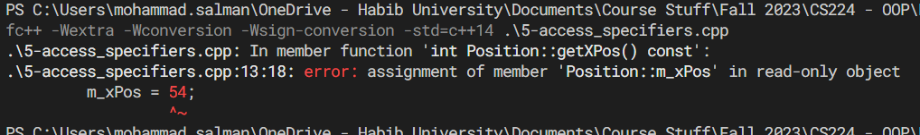
Note that I’m trying to change the attribute of the implicit object here.

Slide 38
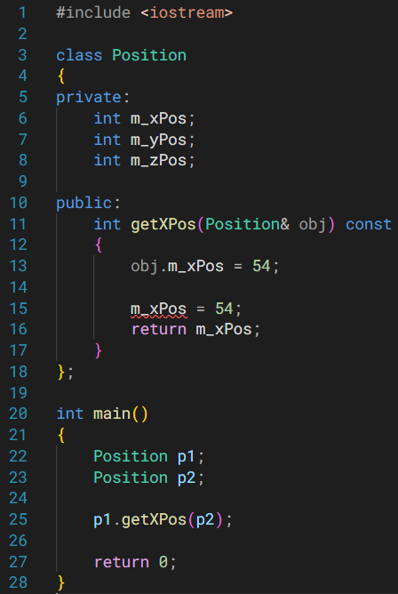
I cannot change the attribute of the implicit object (which is p1 in this e.g.).
But I could change the attribute of another object that was passed to this const method if I wanted to.
Over here, I’m changing the attribute of obj (or p2), which is fine.
If I wanted to prevent changes to obj (or p2) as well, I could pass it by const reference.

Slide 39
Note for Students (Recommended for all OOP Concepts)
Would recommend running the code we’ve seen on Python Tutor.
The visualization may help you understand.
Some things you may note are,
The class definition by itself will not create any entity in memory – no space occupied.
It is when you create an object does memory gets used up.
Note what the attributes get initialized to.
How can we change it?

